Slide 1
Explanations in recommender systems
Nisheeth

Slide 2
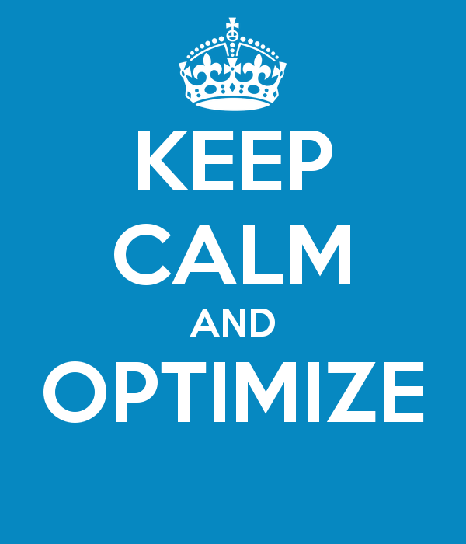
Typical system target

Slide 3
Reality check
What is the real value of recommender systems?
Satisfaction with recommended items, low return rate
F₁ on historical data need not be a good estimate for satisfaction:
Recommendation can be self-fulfilling prophecy
Users’ preferences are not invariant, but can be constructed [ALP03]
position/rank matters (e.g. serial position effects)
Actual choices are heavily biased by the item’s position [FFG+07]
inclusion of weak (dominated) items increases users’ confidence
Replacing some recommended items by decoy items fosters choice towards the remaining options [TF09]

Slide 4
Humans choose poorly
Simplification is an underlying concept of heuristics
Satisficing
Choose the first item that is satisfactory
Elimination by Aspects
Start with the most important attribute
Eliminate all item that are not satisfactory
Proceed with the next most important attribute
Come up with evolved set
Reason-based choice
People want to be able to justify their choices
May make decisions that are easiest to justify

Slide 5
Satisficing: SEME
Study conducted during 2014 Indian general elections
About 2000 participants
Searched for political news related to Rahul Gandhi, Narendra Modi and Arvind Kejriwal
Result display positions were artificially modified to favor searched-for candidate
Typical participant spent 5 minutes on the search engine
Pre- and post-test questionnaires to measure voting propensity
Epstein & Robertson, PNAS, (2015)

Slide 6
Result
Candidate | Rating | χ² | Mean (SE)
 |  |  | Gandhi bias | Kejriwal bias | Modi bias
Gandhi | Impression | 3.61 | −0.16 (0.06) | −0.21 (0.06) | −0.30 (0.06)
 | Trust | 21.19*** | 0.14 (0.06) | −0.04 (0.07) | −0.20 (0.06)
 | Like | 12.99** | −0.09 (0.07) | −0.17 (0.06) | −0.34 (0.06)
 | Voting likelihood | 10.79** | 0.16 (0.07) | −0.04 (0.07) | −0.18 (0.07)
Kejriwal | Impression | 17.75*** | −0.30 (0.06) | −0.11 (0.06) | −0.39 (0.05)
 | Trust | 26.69*** | −0.17 (0.07) | 0.15 (0.06) | −0.16 (0.06)
 | Like | 24.74*** | −0.31 (0.06) | 0.05 (0.06) | −0.23 (0.06)
 | Voting likelihood | 13.22** | −0.03 (0.06) | 0.17 (0.07) | −0.12 (0.06)
Modi | Impression | 24.98*** | −0.22 (0.06) | −0.21 (0.06) | 0.12 (0.05)
 | Trust | 18.78*** | −0.04 (0.06) | −0.10 (0.06) | 0.23 (0.06)
 | Like | 16.89*** | −0.16 (0.05) | −0.09 (0.06) | 0.19 (0.06)
 | Voting likelihood | 31.07*** | −0.07 (0.07) | −0.10 (0.06) | 0.33 (0.06)

Slide 7
Other decision-making heuristics
Phenomenon/Effect | Description
Decoy effects | Additional irrelevant (inferior) items in an item set significantly influence the selection behavior
Primacy/recency effects | Items at the beginning and the end of a list are analyzed significantly more often/deeply than items in the middle of a list
Framing effects | The way in which different decision alternatives are presented influences the final decision taken
Priming | If specific decision properties are made more available in memory, this influences a consumer's item evaluations (background priming)
Defaults | Preset options bias the decision process

Slide 8
Decoy: asymmetric dominance effect
Product A dominates D in both dimensions (price and download limit)
Product B dominates alternative D in only one dimension (price)
The additional inclusion of D into the choice set often triggers an increase in the selection probability of A
Product | A | B | D
price per month | 30 | 20 | 50
download limit | 10GB | 6GB | 9GB

Slide 9
In sum
Recommender systems are persuasion systems
People can be persuaded by very flimsy reasons
Bounded rationality / accuracy-effort-tradeoff makes users susceptible for decision biases
Presenting justifications is necessary to help people choose for the right reasons

Slide 10
Why bother with explanations?
Motivation
“The digital camera Profishot is a must-buy for you because . . . .”
Why should recommender systems deal with explanations at all?
The answer is related to the two parties providing and receiving recommendations:
A selling agent may be interested in promoting particular products
A buying agent is concerned about making the right buying decision

Slide 11
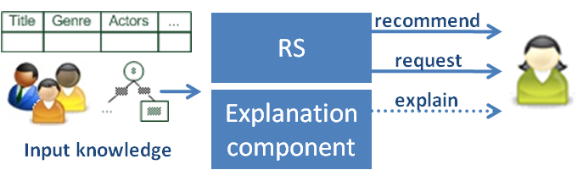
Explanations in recommender systems
Additional information to explain the system’s output following some objectives

Slide 12
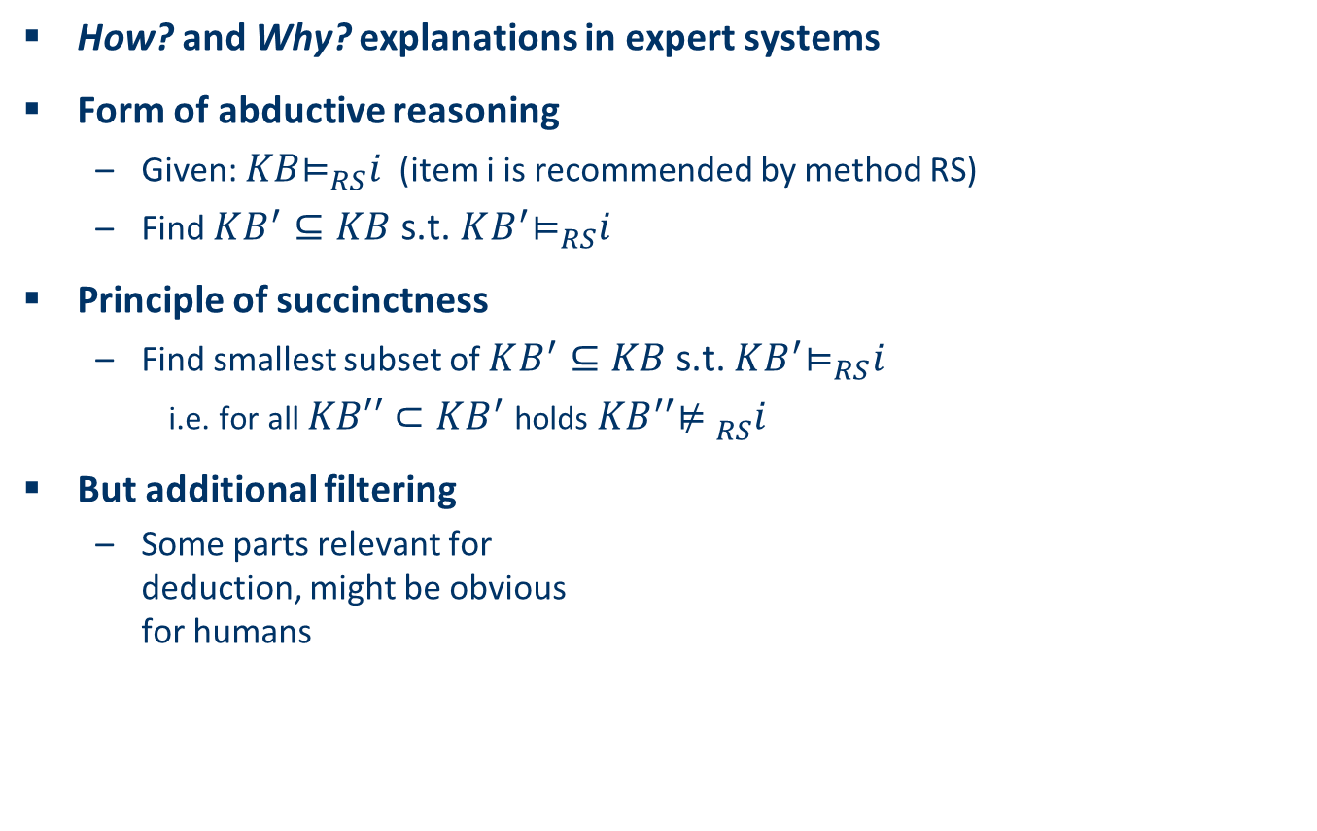
Explanations in general
How? and Why? explanations in expert systems
Form of abductive reasoning
Given: ${KB\text{⊨}}_{RS}i$ (item i is recommended by method RS)
Find $KB^{′}⊆KB$s.t. ${KB^{′}\text{⊨}}_{RS}i$
Principle of succinctness
Find smallest subset of $KB^{′}⊆KB$s.t. ${KB^{′}\text{⊨}}_{RS}i$
i.e. for all $KB′′⊂KB^{′}$holds${{ KB}^{′′}\text{⊭} }_{RS}i$
But additional filtering
Some parts relevant for deduction, might be obvious for humans
[Friedrich & Zanker, AI Magazine, 2011]

Slide 13
Evaluating explanations
Transparency (showing its work)
Scrutability (being understandable and fixable)
Trustworthiness (in reducing churn)
Persuasiveness (in making decisions you want)
Effectiveness (in making good decisions)

Slide 14
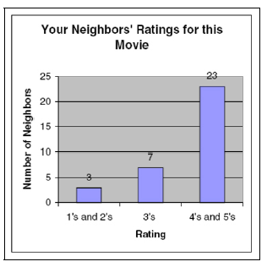
Explanation styles
Social explanations
Natural map to CF
Usually not very persuasive
Transparent
Effective

Slide 15
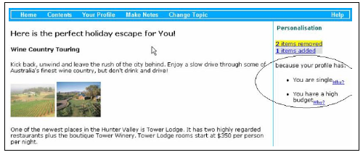
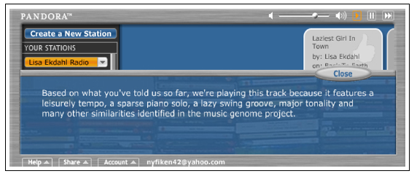
Content-based
Transparent, scrutable (?), persuasive (?), effective, trustworthy

Slide 16
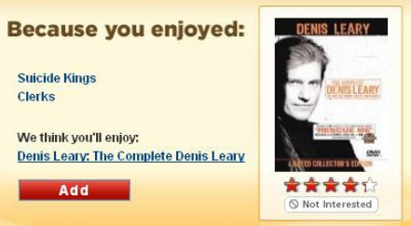
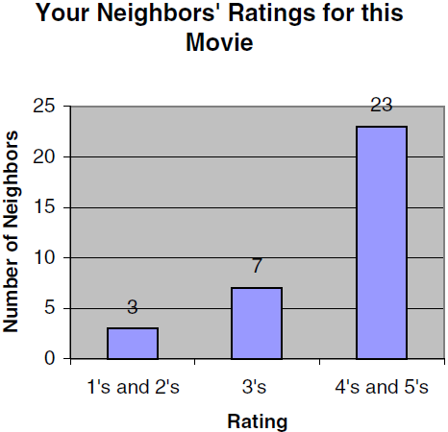
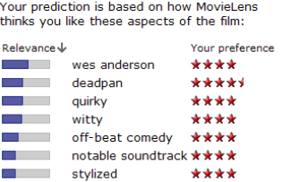
Similarity between items
Similarity between users
Tags
Tag relevance (for item)
Tag preference (of user)

Slide 17
Knowledge-based explanations
Vacation example: “This vacation package differs from your requirements only in price, and is otherwise optimal, no matter what duration, location or ambience you select.”
Trustworthy (?), transparent, scrutable, effective

Slide 18
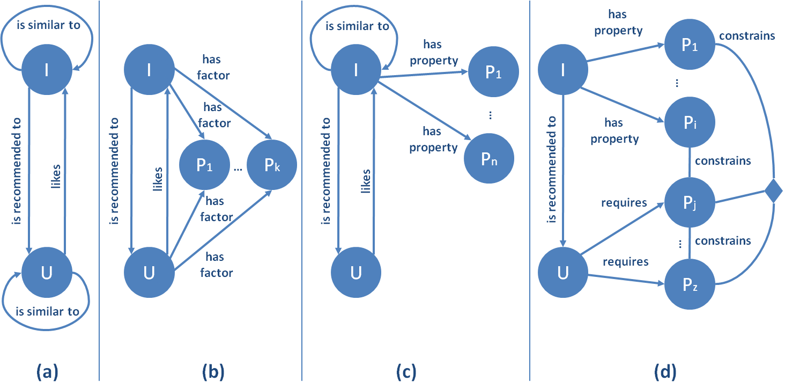
RS paradigms and their ontologies
Classes of objects
Users
Items
Properties
N-ary relations between them
Collaborative filtering
Neighborhood based CF (a)
Matrix factorization (b)
Introduces additional factors as proxies for determining similarities

Slide 19
RS paradigms and their ontologies
Content-based
Properties characterizing items
TF*IDF model
Knowledge based
Properties of items
Properties of user model
Additional mediating domain concepts

Slide 20
An important tradeoff
CF
Content-based
Ease of prediction
Ease of explanation
Knowledge-based

Slide 21
Results from testing explanation systems
+**
Positive
Usage exp.
Perceived
Utility
+**
+*
Recommend others
+**
Explanation
+
Intention to repeated usage
+**
Trust
** sign. < 1%, * sign. < 5%
Knowledgeable explanations significantly increase users’ perceived utility
Perceived utility strongly correlates with usage intention etc.

Slide 22
Explanations in recommender systems: Summary
There are many types of explanations and various goals that an explanation can achieve
Which type of explanation can be generated depends greatly on the recommender approach applied
Explanations may be used to shape the wishes and desires of customers but are a double-edged sword
On the one hand, explanations can help the customer to make wise buying decisions;
On the other hand, explanations can be abused to push a customer in a direction which is advantageous solely for the seller
Understanding explanations and their effects on customers is very important.

